Slide 1
Piatra Craiului National Park
~Brasov~

Slide 2
The Piatra Craiului National Park represents an area with steep peaks (Vârful Țimbalul Mare - 2,177 m, Vârful dintre Țimbale - 2,170 m) of metamorphic rock, calcareous rocks of Jurassic age, grottoes, alpine gaps, quays (Zărneștiului Gorge, Vlădușca Gorge, Dâmbovicioarei Gorge ), caves, marsh holes, watercourses or karst areas resulting from the erosion or corrosion of rocks; mountain meadows, hayfields, pastures, wooded areas,.
The national park overlaps the site of community importance - Piatra Craiului[9] and includes the natural reserves: Cheile Zărneștilor (protected area of ​​geological, floristic, faunal and landscape interest, also known as Prăpăstiile Zărneștilor), Liliecilor Cave (Rucăr-Bran) , Dâmbovicioara Cave, Avenul din Grind, Dâmbovicioara - Brusturet karst area, Dobreștilor Cave, Cave no. 15, Stanciului Cave and Uluce Cave.

Slide 3
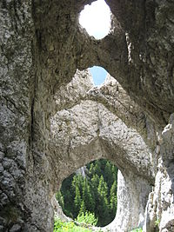
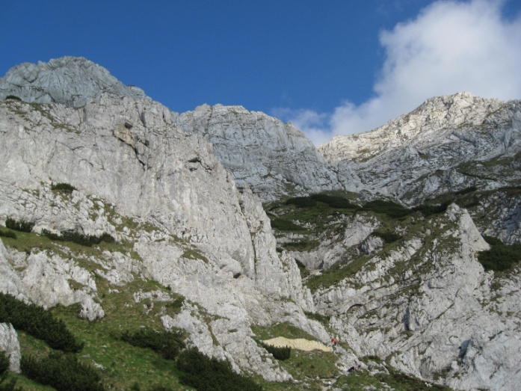
The natural area has several types of habitats (Alpine and boreal thickets, Sub-Arctic Salix thickets, Pinus mugo and Rhododendron myrtifolium thickets, Calciphilous rupicolous communities or basiphyte meadows of Alysso-Sedion albi, Edge communities with tall grasses hygrophilous from the level of the plains, to the mountain and alpine, Alpine and subalpine calciphilous meadows, Mountain meadows, Caves where public access is prohibited, Alluvial forests with Alnus glutinosa and Fraxinus excelsior (Alno-Padion, Alnion incanae, Salicion albae), Dacian beech forests (Symphyto-Fagion), Pinus sylvestris relict forests on calcareous substrate, Luzulo-Fagetum type beech forests, Cephalanthero-Fagion mid-European beech forests, Picea abies acidophilic forests in the mountain region (Vaccinio- Piceetea), Sub-Arctic Salix thickets, Rocky slopes with chasmophytic vegetation on siliceous rocks, Herbaceous vegetation on the banks of montane rivers, Woody vegetation with Myricaria germanica along montane rivers and Calcareous and calcareous shale screes on the montane floor up to the alpine (Thlaspietea rotundifolii) that house a diverse range of flora and fauna specific to Pietra Craiului

