Slide 1
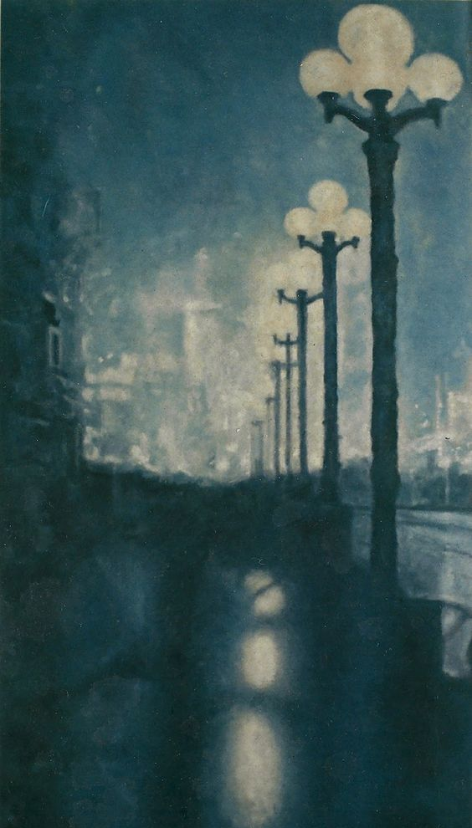
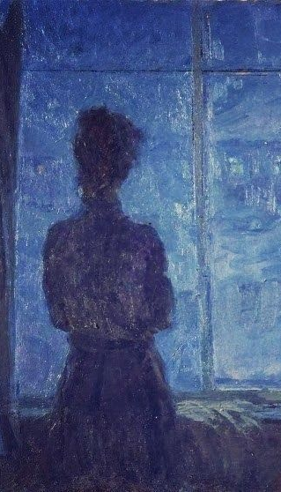
''The War in the Midnight Rain''
Story wrote by: Lazăr Maria Mădălina
7th grade

Slide 2
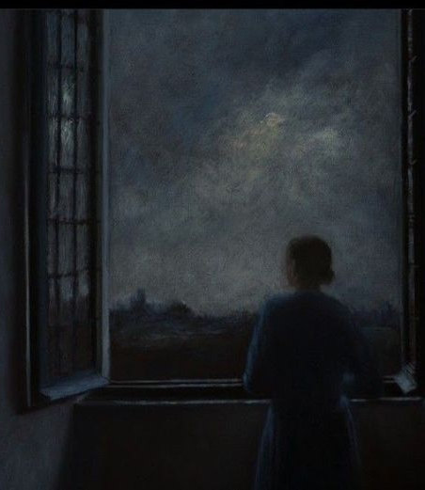
This is a fantast romance tale about the love story between a supranatural being named Myul Mang, who causes everything he touches to vanish, and a woman named Tak Dong Kyung, who puts her life on the line to avoid fer fate. When we’re having a rought day,nothing seems better than the end of the world. End the suffering at once, right? In a moment of despair, a lot of us have probably wished for it. We don't except such wishes to become reality, except,Tak Dongk yung’s wish actually comes true. Myul Mang, who is doom personified, and whose existence serves the purpose of ruination, chooses to fulfill Tak Dongk- yung’s wish. But then they strike a deal, and unexpectedly fall in love along the way. The central theme of the story is “love conquers”. The love between Dong kyung and Myul Mang is unlikely, because she doesn't have much time left to live ,and Myul Mang is immortal,he is quite literally doom .But as they understand each other , they grow closer and fall in love deeply enough to risk the entire world.And their love is what changes their doomed fate in the end. Though the world may be bleak and filled with obstacles that seems impossible to overcome, it is love that saves us, and we must learn to cherish it. Love is not something that we find, it's something that finds us.

Slide 3
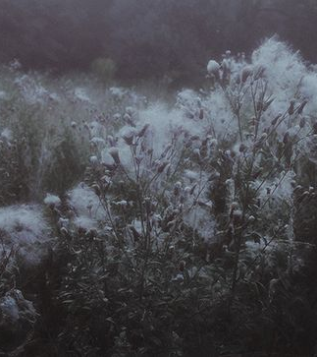
An editor from a web novel company, lives a fairly ordinary life until she stumbles into a unexpected fate . All in a single day ,she finds out she is dying from glioblastoma and has only three months to live, learns that her boyfriend is a father-to-be and has a wife, gets scolded by her superior at work, and is spied on by a pervert before that pervert falls into a sinkhole .Drinking her problems away, she happens to see a shooting star from her rooftop apartment and drunkenly wishes for the world to be doomed. Her wish is heard by Myul Mang a messenger between gods and humans who only follows fate without any intention nor passion. Growing tired of his immortal life of bring misfortune and destruction, he decides to end the world and thus bring doom upon himself. The only thing that connects the two of the them is the bracelet that the doom itself offered her as a promise that she will never break the contract. The deity, the creator of the doom was against this ideea from the beginning , since she knew how things would end up for both of them. If he ever felt compassion for her, if he ever felt in love with her... everything was in vain. Even after loosing both of their mememories and overcoming all the hardships they went throught, they were finally able to live a peaceful life,as they wanted from the start. Not everything comes for free ,of course. He was disfranchised from his rights of being a deity. After all, they proved that nothing’s impossible, unless you desire something so much you would go as far as you can for it. Their love is the definiton of ‘’pure love’’, that would sacrifice everything they are in possesion of,even their lifes. As he gives in, and sacrifice itself for her, the deity finally realize that the doom isn’t neede anymore in her garden,where humans represente the flowers. Their love story is heartwarming , and letting people know that you can break your boundries for something you yearn for It’s a must.

